Slide 1
SEMINAR III Towards Detecting Dictionary Based Malicious Domain Names
Mr. Amir Mukeri
M.E. (Computer Engineering) Candidate
Roll No. 18MC001
Department of Computer Engineering
mukeriamir@gmail.com
Under the guidance of:
Dr. D.P. Gaikwad
Department of Computer Engineering

Slide 2
Malware Communication
Host infected by malware communicates with attacker’s Command & Control (C&C)
Communication is for
Data exfiltration
Downloading encryption keys for ransomware attacks
Instructions for further download and spread of malware

Slide 3
Algorithmically Generated Domain (AGD)
Domain name for C&C are nowadays generated algorithmically, Algorithmically Generated Domain (AGD) domain names.
Random gibberish: ocufxskoiegqvv.com
More sophisticated Domain Generation Algorithm(DGA) such as matsnu and suppobox are relying on valid dictionary based domain names: scoreadmireluckapplyfitcouple.com
Dictionary wordlist based domain names are difficult to detect and block.

Slide 4
Related Work
Kührer et al. evaluated the public and vendor provided blacklist based approach to blocking malicious domain names. They found that these blacklist contained only 20% of major domains from malware families and failed to provide any protection against AGD names.
Antonakakis et al. suggested clustering and classification based approach to process the domain names in respective DGA families.
Bahnsen et al. found RNNs to be more superior in performance compared to random forest based models.
Woodbridge et al. used Long Short Term Memory (LSTM) architecture to detect the AGD names. Their proposed method improved accuracy of detection however faced challenges when it comes to dictionary or wordlist based DGA.
A hybrid neural network approach comprising of parallel CNN and attention based Bi-LSTM layers was designed by Yang et al.
Fangali et al. used CNN, Bi-LSTM and Attention layer after the embedding layer to do the detection as well as multiclass classification of various DGAs

Slide 5
Gap Analysis
Machine Learning based approaches involve feature selection and engineering and found to be inadequate in detecting malicious domain names.
Most of the current state of the art faces challenge in detecting and classifying dictionary based domain names.

Slide 6
Proposed Work
Analysis of effectiveness of various deep learning models in detecting and classifying malicious domain names (both random and dictionary based).
Design of AGD detector and classifier based on transfer learning in Transformer architecture.

Slide 7
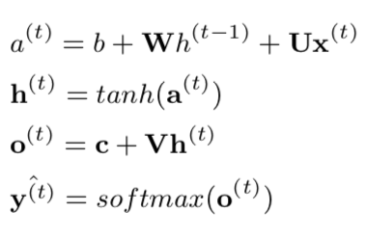
Recurrent Neural Network(RNN)
Handles variable sequence inputs
Recurrent loop from output to inputs to handle variable length data
Weights are shared across layers
Backpropagation Through Time (BPTT)
U,V,W are weight matrices, b and c are biases, h is a hidden state. Hidden state at a time t is an input to next time step t+1. Final layer is a softmax layer that gives a valid probability distribution over output sequence.

Slide 8
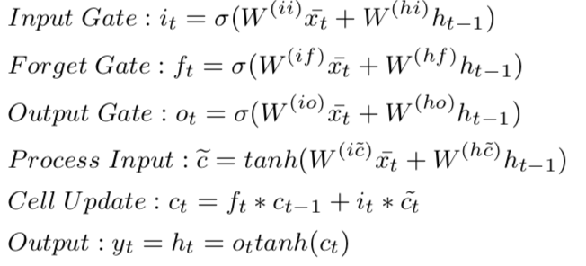
Long Short Term Memory(LSTM)
Special gated structure with three gates to control memorization and forgetting in RNN.
Mitigate the problem of vanishing gradients and also allows for remembering over long range.
Bi-LSTM: two LSTM layers, one processes words in a sentence in forward and another in backward direction since many times context in one direction is not sufficient for prediction or in language modeling tasks.
Changes from RNN include, hidden state ht becomes cell state ct and output yt becomes hidden state ht

Slide 9
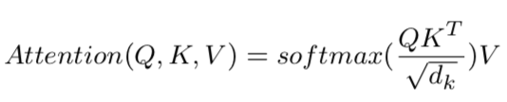
Transformers
Attention Mechanism: Helps in focusing for more relevant words in sentence while deciding how much importance to give to which part.
Attention is basically a scaled dot product that assigns probability distribution over keys that are closely aligned to query vector Q
Transformer remove the recurrent layers thereby reducing the training time and making it possible to take advantage of parallel operations which was not possible with RNN due to sequential series of operations.
Notes:
Transformer architecture consists of encoder and decoder. Consider an example of machine translation task.
Source language statement is embedded and processed by encoder while the target language translation so far is produced by decoder one token at a time.
Implementation of Transformer architecture was found to outperform all the state of the art machine translation benchmark and soon became the state 0f the art mode for machine translation and other NLP tasks.

Slide 10
Bidirectional Encoder Representations from Transformer(BERT)
Bidirectional Encoder Representations from Transformer (BERT) by Devlin et al. in 2018 that takes benefit of transfer learning.
Transfer learning allows model trained on different dataset to be utilized for specific downstream task.
BERT is based on Transformer architecture however it only uses encoder from Transformer.

Slide 11
Training BERT
Training BERT happens in two steps viz. Pre-training and Fine-Tuning.
In pre-training phase, through unsupervised learning BERT develops natural language understanding using Masked Language Modeling(MLM) and Next Sentence Prediction (NSP).
MLM: unsupervised task where a random word is masked in a sentence and model predicts the probability distribution of output words.
For language modeling BERT uses deep bidirectional model instead of using only left-to-right or concatenated two model outputs.
NSP: given a pair of sentences A and B, if B follows A then its labelled as IsNext otherwise NotNext.
In fine-tuning phase, BERT is trained for task specific labeled dataset such as sentiment classification or Question-Answering. In this phase, pre-trained model is trained end-to-end and all the parameters are fine tuned for specific task. This is relatively inexpensive and less time consuming training.
BERT is pertained on Wikipedia and BookCorpus dataset.
BERTbase model with total of 110M parameters.

Slide 12
Dataset
Real world domain names generated using domain generation algorithms were used for experimental analysis from UMU DGA dataset.
Dataset consisted of 110,000 legitimate domain names and approximately 10000 domain names generated using various DGAs.
Dataset was split into training and test dataset with a proportion of 70%:30% of randomly chosen samples.
Pre-processing:
Entire dataset was encoded using character level encoding.
Output labels belonging to 19 different DGAs were represented using one hot encoding.
Pre-padding was done in case domain names were smaller than maximum domain length.

Slide 13
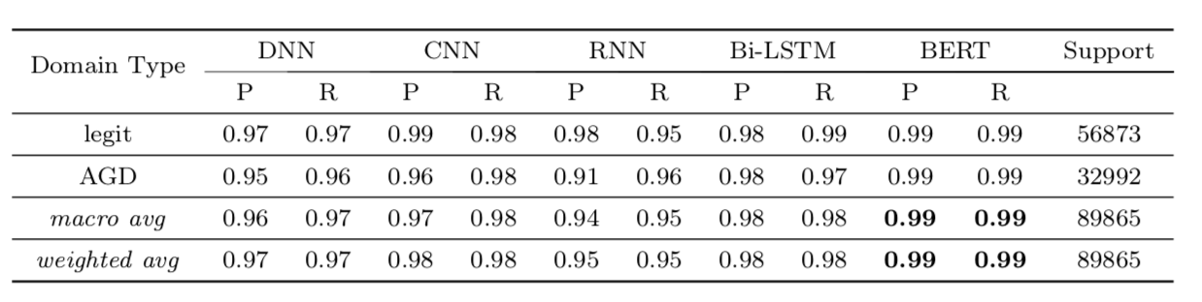
Results DGA Detection
Proposed BERT model provides more than 9 point absolute improvement over recent results reported by Yang et al. and by Fangali et al.

Slide 14
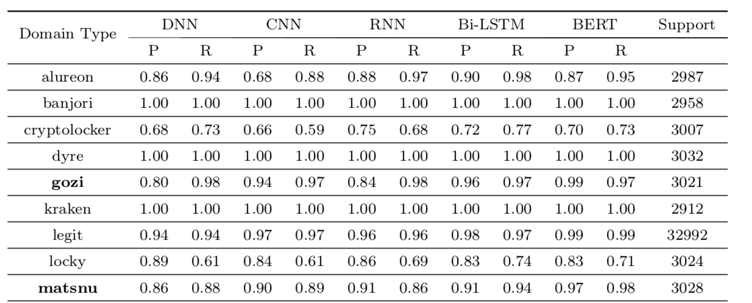
DGA Classification
Classification efficacy of BERT model is highest for dictionary based such as gozi, matsnu, and suppobox.
BERT based classifier outperforms other recent results for both dictionary based and random DGAs.

Slide 15
Conclusion

Slide 16
Acknowledgements
Special thanks to my thesis guide Dr. D.P. Gaikwad for his guidance and support.

Slide 17
References
Akhtar, Naveed, Jian Liu, and Ajmal Mian (2018). “Defense against universal adver- sarial perturbations”. In: Proceedings of the IEEE Conference on Computer Vision and Pattern Recognition, pp. 3389–3398.
Alhajjar, Elie, Paul Maxwell, and Nathaniel D Bastian (2020). “Adversarial Machine Learning in Network Intrusion Detection Systems”. In: arXiv preprint arXiv:2004.11898.
Apruzzese, Giovanni et al. (2020). “Hardening Random Forest Cyber Detectors Against Adversarial Attacks”. In: IEEE Transactions on Emerging Topics in Computa- tional Intelligence 4.4, pp. 427–439.
Arjovsky, Martin, Soumith Chintala, and Léon Bottou (2017). “Wasserstein generative adversarial networks”. In: International conference on machine learning. PMLR, pp. 214–223.
Carlini, Nicholas and David Wagner (2017). “Towards evaluating the robustness of neural networks”. In: 2017 ieee symposium on security and privacy (sp). IEEE, pp. 39–57.
Dhanabal, L and SP Shantharajah (2015). “A study on NSL-KDD dataset for intru- sion detection system based on classification algorithms”. In: International Journal of Advanced Research in Computer and Communication Engineering 4.6, pp. 446– 452.
Elsken, Thomas, Jan Hendrik Metzen, Frank Hutter, et al. (2019). “Neural architec- ture search: A survey.” In: J. Mach. Learn. Res. 20.55, pp. 1–21.
Gaikwad, DP and Amir Mukeri (2020). “Fine Tuned Deep Neural Networks for In- trusion Detection System”. In: Journal of Network Security Computer Networks 6.2, p. 9.
Goodfellow, Ian J, Jonathon Shlens, and Christian Szegedy (2014). “Explaining and harnessing adversarial examples”. In: arXiv preprint arXiv:1412.6572.
Hashemi, Mohammad J and Eric Keller (2020). “Enhancing Robustness Against Ad- versarial Examples in Network Intrusion Detection Systems”. In: 2020 IEEE Con- ference on Network Function Virtualization and Software Defined Networks (NFV- SDN). IEEE, pp. 37–43.
Hosseini, Hossein et al. (2017). “Blocking transferability of adversarial examples in black-box learning systems”. In: arXiv preprint arXiv:1703.04318.
HTTP DATASET CSIC 2010 (n.d.). https://www.isi.csic.es/dataset/. (Ac- cessed on 02/14/2021).
Huang, Ling et al. (2011). “Adversarial machine learning”. In: Proceedings of the 4th ACM workshop on Security and artificial intelligence, pp. 43–58.
Javaid, Ahmad et al. (2016). “A deep learning approach for network intrusion de- tection system”. In: Proceedings of the 9th EAI International Conference on Bio- inspired Information and Communications Technologies (formerly BIONETICS), pp. 21–26.
Kholidy, Hisham A and Fabrizio Baiardi (2012). “Cidd: A cloud intrusion detection dataset for cloud computing and masquerade attacks”. In: 2012 Ninth Interna- tional Conference on Information Technology-New Generations. IEEE, pp. 397– 402.
Kumar, Raneel, Sunil Pranit Lal, and Alok Sharma (2016). “Detecting denial of ser- vice attacks in the cloud”. In: 2016 IEEE 14th Intl Conf on Dependable, Autonomic and Secure Computing, 14th Intl Conf on Pervasive Intelligence and Computing, 2nd Intl Conf on Big Data Intelligence and Computing and Cyber Science and Technology Congress (DASC/PiCom/DataCom/CyberSciTech). IEEE, pp. 309– 316.

Slide 18
References
LeCun, Yann, Yoshua Bengio, and Geoffrey Hinton (2015). “Deep learning. nature 521 (7553), 436-444”. In: Google Scholar Google Scholar Cross Ref Cross Ref.
Lin, Zilong, Yong Shi, and Zhi Xue (2018). “Idsgan: Generative adversarial networks for attack generation against intrusion detection”. In: arXiv preprint arXiv:1809.02077. Liu, Lan et al. (2020). “Deep Learning-Based Network Security Data Sampling and Anomaly Prediction in Future Network”. In: Discrete Dynamics in Nature and Society 2020.
Moorthy, Manthira and M Rajeswari (2013). “Virtual host based intrusion detec- tion system for cloud”. In: International Journal of Engineering & Technology, pp. 0975–4024.
Moosavi-Dezfooli, Seyed-Mohsen, Alhussein Fawzi, and Pascal Frossard (2016). “Deep-fool: a simple and accurate method to fool deep neural networks”. In: Proceedings of the IEEE conference on computer vision and pattern recognition, pp. 2574–2582.
Moustafa, Nour and Jill Slay (2015). “UNSW-NB15: a comprehensive data set for network intrusion detection systems (UNSW-NB15 network data set)”. In: 2015 military communications and information systems conference (MilCIS). IEEE, pp. 1–6.
Mukeri, Amir and DP Gaikwad (2020). “Support Vector Machine and Principal Com- ponent Analysis for Intrusion Detection System”. In: i-Manager’s Journal on Software Engineering 14.3, p. 42.
NSL-KDD Datasets (n.d.). https://www.unb.ca/cic/datasets/nsl.html. (Accessed on 02/13/2021).
Panda, Mrutyunjaya et al. (2011). “Network intrusion detection system: A machine learning approach”. In: Intelligent Decision Technologies 5.4, pp. 347–356.

Slide 19
Appendix

